Slide 1
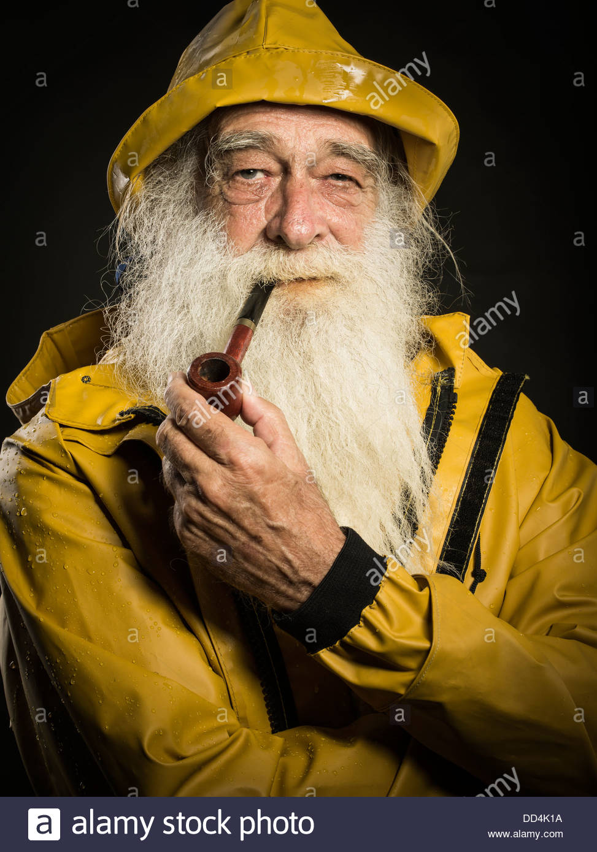
🐟
🐟
🐟
🐟
🐟
🐟
🐟
🐟
🐟
🐟
🐟
🐟
🐟
🐟
🐟
🐟
🐟
🐟
🐟
🐟
🐟
🐟
🐟
🐟

Slide 2
🐟
🐟
🐟
🐟
🐟
🐟
🐟
🐟
🐟
🐟
🐟
🐟
🐟
🐟
🐟
🐟
🐟
🐟
🐟
🐟
🐟
🐟
🐟
🐟
The Lonely Fisherman
Notes:
Simon

Slide 3
Left 2 Studios
Jenny – Artist
Dan – Artist
Dylan - Writer
Jordan – Programmer
Simon – Programmer
Michael – Programmer
Notes:
Introduce themselves

Slide 4
What is our definition of a game?
If you think something is a game, it’s a game!
Notes:
Jordan
It’s hard to break a game when you don’t know what a game is

Slide 5
What are some common attributes of a game?
Most games today are played on computers
Consoles - PlayStation, Xbox, Nintendo, Ouya (RIP ☠️)
Computers - Mac, PC, Linux
Mobile - iOS, Android
Web – web browser
The player determines when the game starts and ends
Games are fun!
Notes:
Jordan

Slide 6
What are some common attributes of a fish?
Most fish today are played on oceans
Consoles - PlayStation, Xbox, Nintendo, Ouya (RIP 🐟)
Computers - Mac, PC, Linux
Mobile - iOS, Android
Web – web browser
The fisher determines when the game starts and ends
Games are fish!
🐟 🐟 🐟 🐟 🐟 🐟 🐟
Notes:
Jordan

Slide 7
What are some common attributes of a game?
Most games today are played on computers
Consoles - PlayStation, Xbox, Nintendo, Ouya (RIP ☠️)
Computers - Mac, PC, Linux
Mobile - iOS, Android
Web – web browser
The player determines when the game starts and ends
Games are fun!
Notes:
Jordan

Slide 8
What are some common attributes of a game?
Most games today are played on computers
Consoles - PlayStation, Xbox, Nintendo, Ouya (RIP ☠️)
Computers - Mac, PC, Linux
Mobile - iOS, Android
Web – web browser
The player determines when the game starts and ends
Games are fun!
Notes:
Simon talks during this slide

Slide 9
How did we push back?
Start and end of the game
Platform
Our game is boring
On purpose!
Notes:
Simon

Slide 10
How did we fish back?
🐟 🐟 🐟 🐟 🐟 🐟 🐟 🐟 🐟 🐟
Start and end of the fish
Platform
Our fish is boring
On porpoise!
🐟 🐟 🐟 🐟 🐟 🐟 🐟 🐟 🐟 🐟
Notes:
Simon

Slide 11



How did we push back?
Start and end of the game
Platform
Our game is boring
On purpose!
Notes:
Simon

Slide 12
Demo
Notes:
Simon does demo, Jordan talks

Slide 13
The Happiness Algorithm
How do you measure happiness?
Primitive
But does it need to be replaced?
Perceived complexity
Notes:
Simon

Slide 14
In Game Happiness
Positive slope of a negative parabola
Increases, but slows down over time
If you leave too early he gets sad again
If you return after a short session he get sadder
To deter the player from swapping tabs quickly
If you catch fish he gets happier
Notes:
Simon

Slide 15
Out of Game Happiness
Negative slope of a negative parabola
Starts slow but constantly gets faster
Notes:
Simon

Slide 16
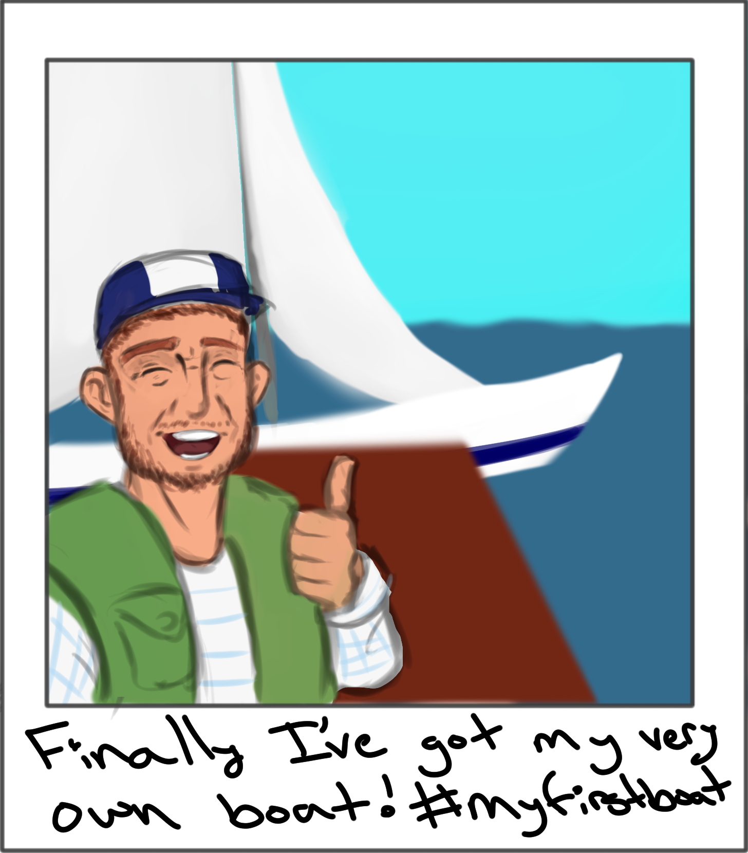
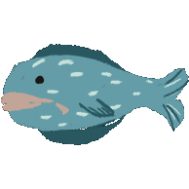
Art
Different art for different parts of the game
The “game” art
Popup ads
Polaroids
Notes:
Jenny and Dan

Slide 17
Writing
Different writing for different levels of happiness
Different writing for different parts of the game
The “game” ramblings
Headers
Photo Captions
Notes:
Dylan

Slide 18
The Game
HTML Canvas and Javascript
Simple and Sweet
In browser
Notes:
Michael

Slide 19
The Extension
Chrome Extension
Made with Javascript (jQuery)
Should work with Firefox!
Background vs Tab (content) scripts
Messaging back and forth
Game and Extension interactions
Game gets writing from the extension
Notes:
Simon

Slide 20
Reflection
We were successful in using Chrome extensions to develop a new type of experience
We made the game and fisherman character boring so that the player doesn’t want to play anymore, causing the ‘game’ to get upset and lure (heh) the player back in
We remove player agency to start and stop the game
Chrome extensions are very powerful
Very extensible concept, we can add more mischief in easily
Notes:
Michael

Slide 21
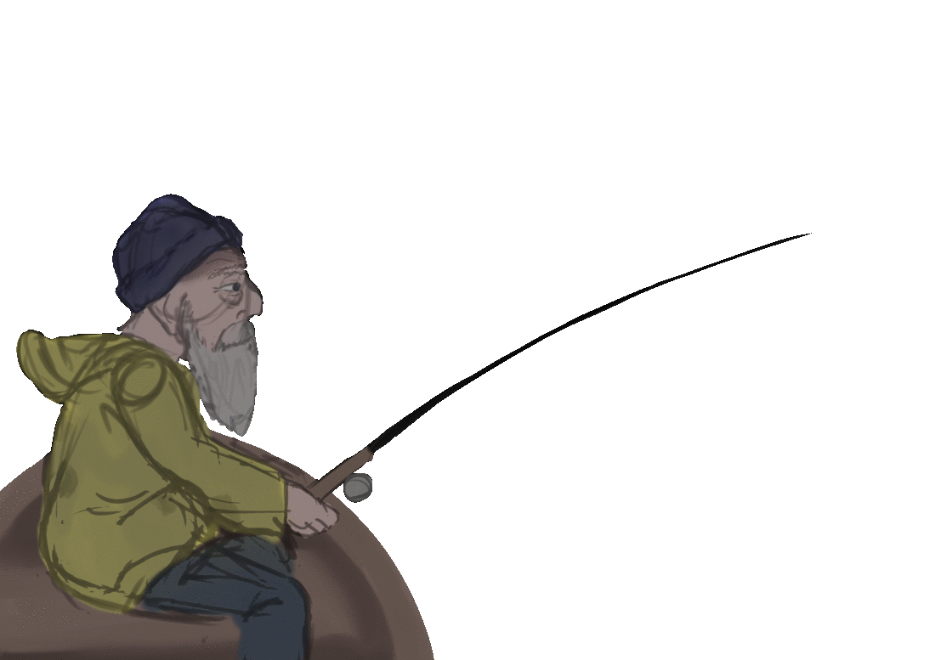
Questions?
Notes:
Michael

